Slide 1

Linux Basics ( course VI )
I am
root!
Florentiu Ilie

Slide 2
Course Content
Course1: Startup and Shutdown +
Course2: Linux directory tree, SSH
Course3: File permissions, Environment variables +
Course4: Users, Groups, Jobs +
Course5: Processes, Logging, Archiving
Course6: Disk Partitioning, Filesystems
Course7: LVM
Course8: Backup, Useful commands
Course9: Networking
Course10: Basic Troubleshooting

Slide 3
Schedule
Initialization Test (20m)
Course 1-2(1h each)
Test 2 (20m)
Course 3-5
Test 3 (50m)
Course 6-7
Test 4 (30m)
Project ( 7days)
Project presentation (1h each student)
Course 8-10
Test 5 (20m)
Review of all courses 1-10 (1-2h)
Final Test 1 – theoretical (1h)
Final Test 2 – practical (1-2h)

Slide 4
disk Partionting
Data is stored on disk drives that are logically divided into partitions.
A partition can exist on an entire disk, or it can span multiple disks.
tool to make partitions: FDISK
options:
fdisk –l ( list partitions/disks )
fdisk /dev/sda ( select a disk to edit – create/delete/modify partiton )
partprobe ( used mostly on virtual machines to reread the partition tables )

Slide 5
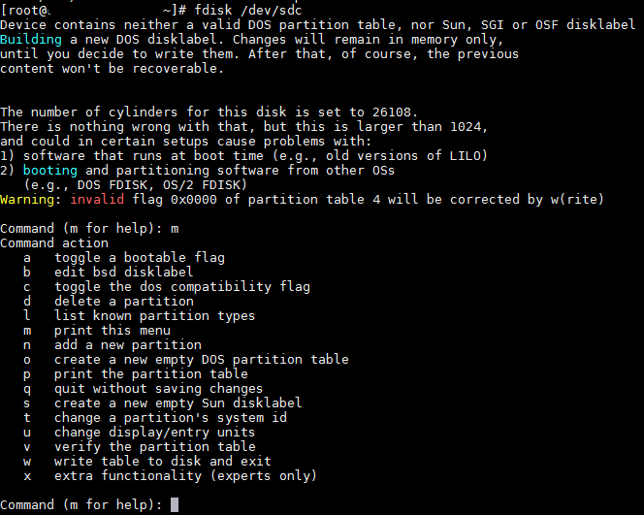
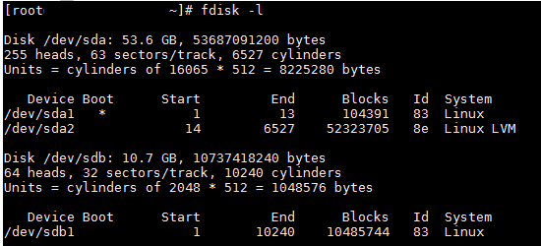
FDISK
The fdisk tool is commonly used to carve up disks on RHEL/CentOS systems. This text-based, menu-driven program allows you to display, add, modify, verify and delete partitions.
fdisk frequent options:
m,n,p,w,d

Slide 6
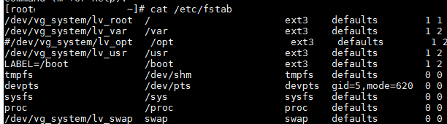
File Systems
file system (or filesystem) is used to control how data is stored and retrieved.
the layer above “everything”
linux filesystem types: ext2,ext3,ext4,xfs
order when creating filesystems:
1) Physically / virtually add a disk to the server
2) Fdisk /dev/sdXX - format the disk with fdisk command
3) mkfs.xfs /dev/sdXX - create a filesystem on top of the partition / disk you have created
4) mount /dev/sdXX /name_directory - mount the filesystem into a directory
5) vi /etc/fstab – edit /etc/fstab to make the mount available at reboot

Slide 7
Filesystems
Useful commands:
mkfs.ext3/mkfs.xfs – create filesystems
mount / umount
tune2fs – adjust filesystem parameters
dumpe2fs – dump ext2/ext3/ext4 filesystem information
resize2fs – resize a ext2/3/4 filesystem
xfs_growfs – resize a xfs filesystem
xfsdump – dump xfs filesystem information
xfs_repair – repair a xfs filesystem
fsck – repair and check a filesystem ( must umount before running this utility )

Slide 8

Questions ?

